Slide 1

CHAPTER 9
COUNTING AND
PROBABILITY
Copyright © Cengage Learning. All rights reserved.

Slide 2
SECTION 9.9
Conditional Probability, Bayes’ Formula, and Independent Events
Copyright © Cengage Learning. All rights reserved.

Slide 3
Conditional Probability, Bayes’ Formula, and Independent Events
In this section we introduce the notion of conditional probability and discuss Bayes’ Theorem and the kind of interesting results to which it leads.
We then define the concept of independent events and give some applications.

Slide 4
Conditional Probability

Slide 5
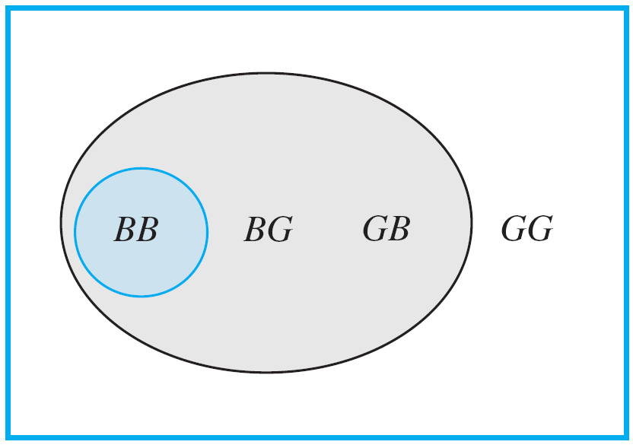
Conditional Probability
Imagine a couple with two children, each of whom is equally likely to be a boy or a girl. Now suppose you are given the information that one is a boy. What is the probability that the other child is a boy?
Figure 9.9.1 shows the four equally likely combinations of gender for the children.
Figure 9.9.1

Slide 6
Conditional Probability
You can imagine that the first letter refers to the older child and the second letter to the younger.
Thus the combination BG indicates that the older child is a boy and the younger is a girl.
The combinations where one of the children is a boy are shaded gray, and the combination where the other child is also a boy is shaded blue-gray.
Given that you know one child is a boy, only the three combinations in the gray region could be the case, so you can think of the set of those outcomes as a new sample space with three elements, all of which are equally likely.

Slide 7
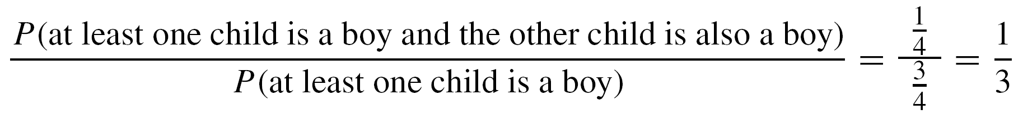
Conditional Probability
Within the new sample space, there is one combination where the other child is a boy (in the region shaded blue-gray).
Thus it would be reasonable to say that the likelihood that the other child is a boy, given that at least one is a boy, is
1/3 = 33 %.
Note that because the original sample space contained four outcomes,
also.

Slide 8
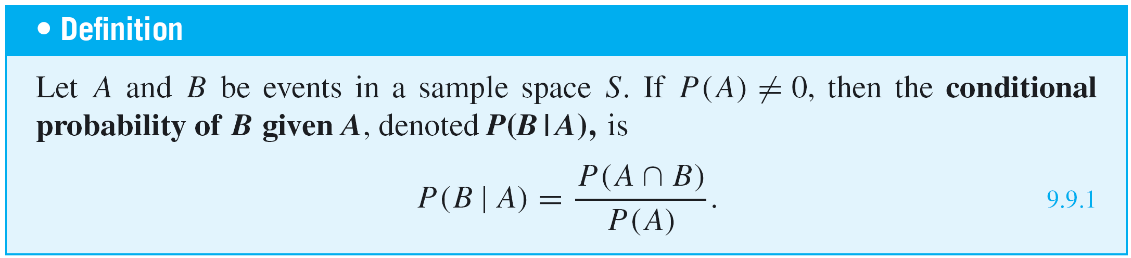
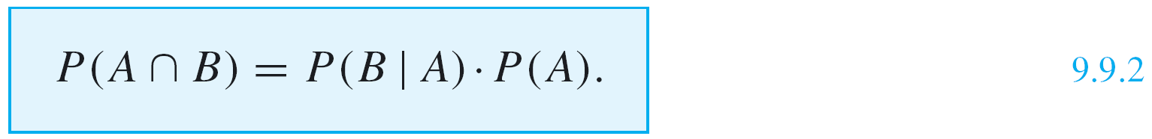
Conditional Probability
A generalization of this observation forms the basis for the following definition.
Note that when both sides of the formula for conditional probability (formula 9.9.1) are multiplied by P(A), a formula for P(A ∩ B) is obtained:

Slide 9
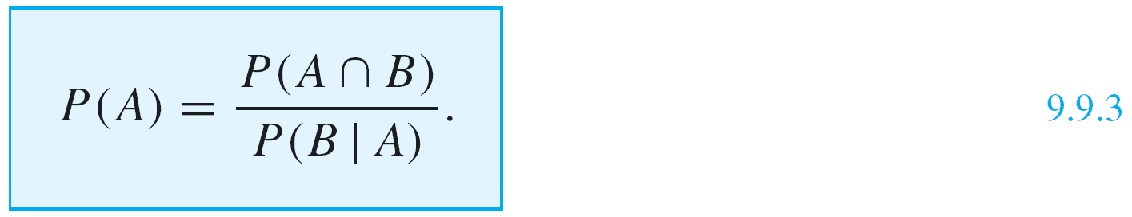
Conditional Probability
Dividing both sides of formula (9.9.2) by P(B | A) gives a formula for P(A):

Slide 10
Example 2 – Representing Conditional Probabilities with a Tree Diagram
An urn contains 5 blue and 7 gray balls. Let us say that 2 are chosen at random, one after the other, without replacement.
a. Find the following probabilities and illustrate them with a tree diagram: the probability that both balls are blue, the probability that the first ball is blue and the second is not blue, the probability that the first ball is not blue and the second ball is blue, and the probability that neither ball is blue.
b. What is the probability that the second ball is blue?

Slide 11
Example 2 – Representing Conditional Probabilities with a Tree Diagram
cont’d
c. What is the probability that at least one of the balls is
blue?
d. If the experiment of choosing two balls from the urn were repeated many times over, what would be the expected value of the number of blue balls?
Solution:
Let S denote the sample space of all possible choices of two balls from the urn, let B₁ be the event that the first ball is blue, and let B₂ be the event that the second ball is blue.

Slide 12


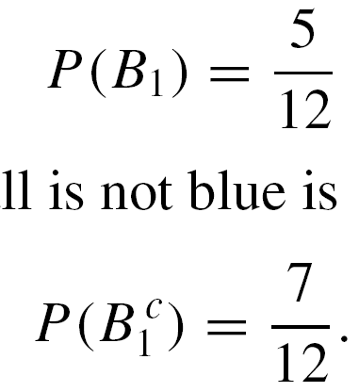
Example 2 – Solution
cont’d
Then is the event that the first ball is not blue and is the event that the second ball is not blue.
a. Because there are 12 balls of which 5 are blue and 7 are
gray, the probability that the first ball is blue is
and the probability that the first ball is not blue is

Slide 13
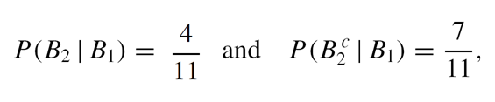
Example 2 – Solution
cont’d
If the first ball is blue, then the urn would contain 4 blue
balls and 7 gray balls, and so
where is the probability that the second ball is
blue given that the first ball is blue and is the
probability that the second ball is not blue given that the
first ball is blue.

Slide 14
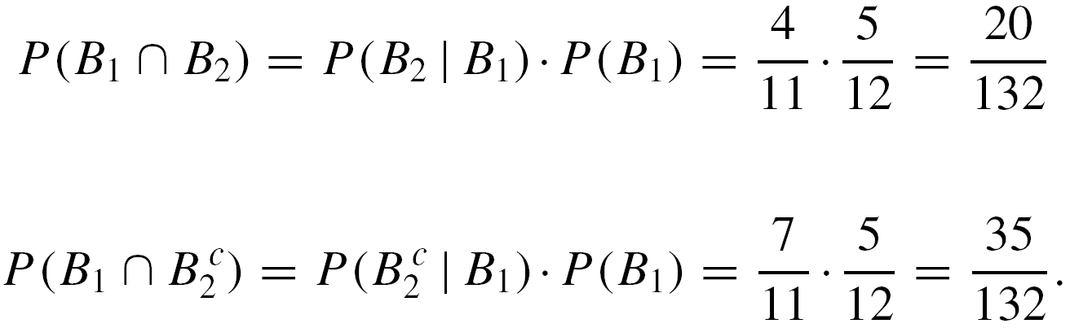
Example 2 – Solution
cont’d
It follows from formula (9.9.2)
that
and

Slide 15
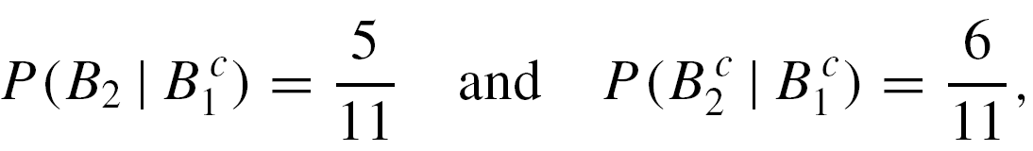
Example 2 – Solution
cont’d
Similarly, if the first ball is not blue, then the urn would
contain 5 blue balls and 6 gray balls, and so
where is the probability that the second ball is
blue given that the first ball is not blue and is
the probability that the second ball is not blue given that
the first ball is not blue.

Slide 16
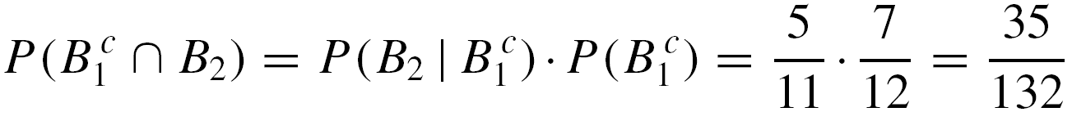
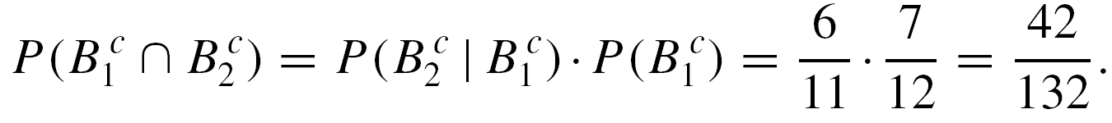
Example 2 – Solution
cont’d
It follows from formula (9.9.2) that
and

Slide 17
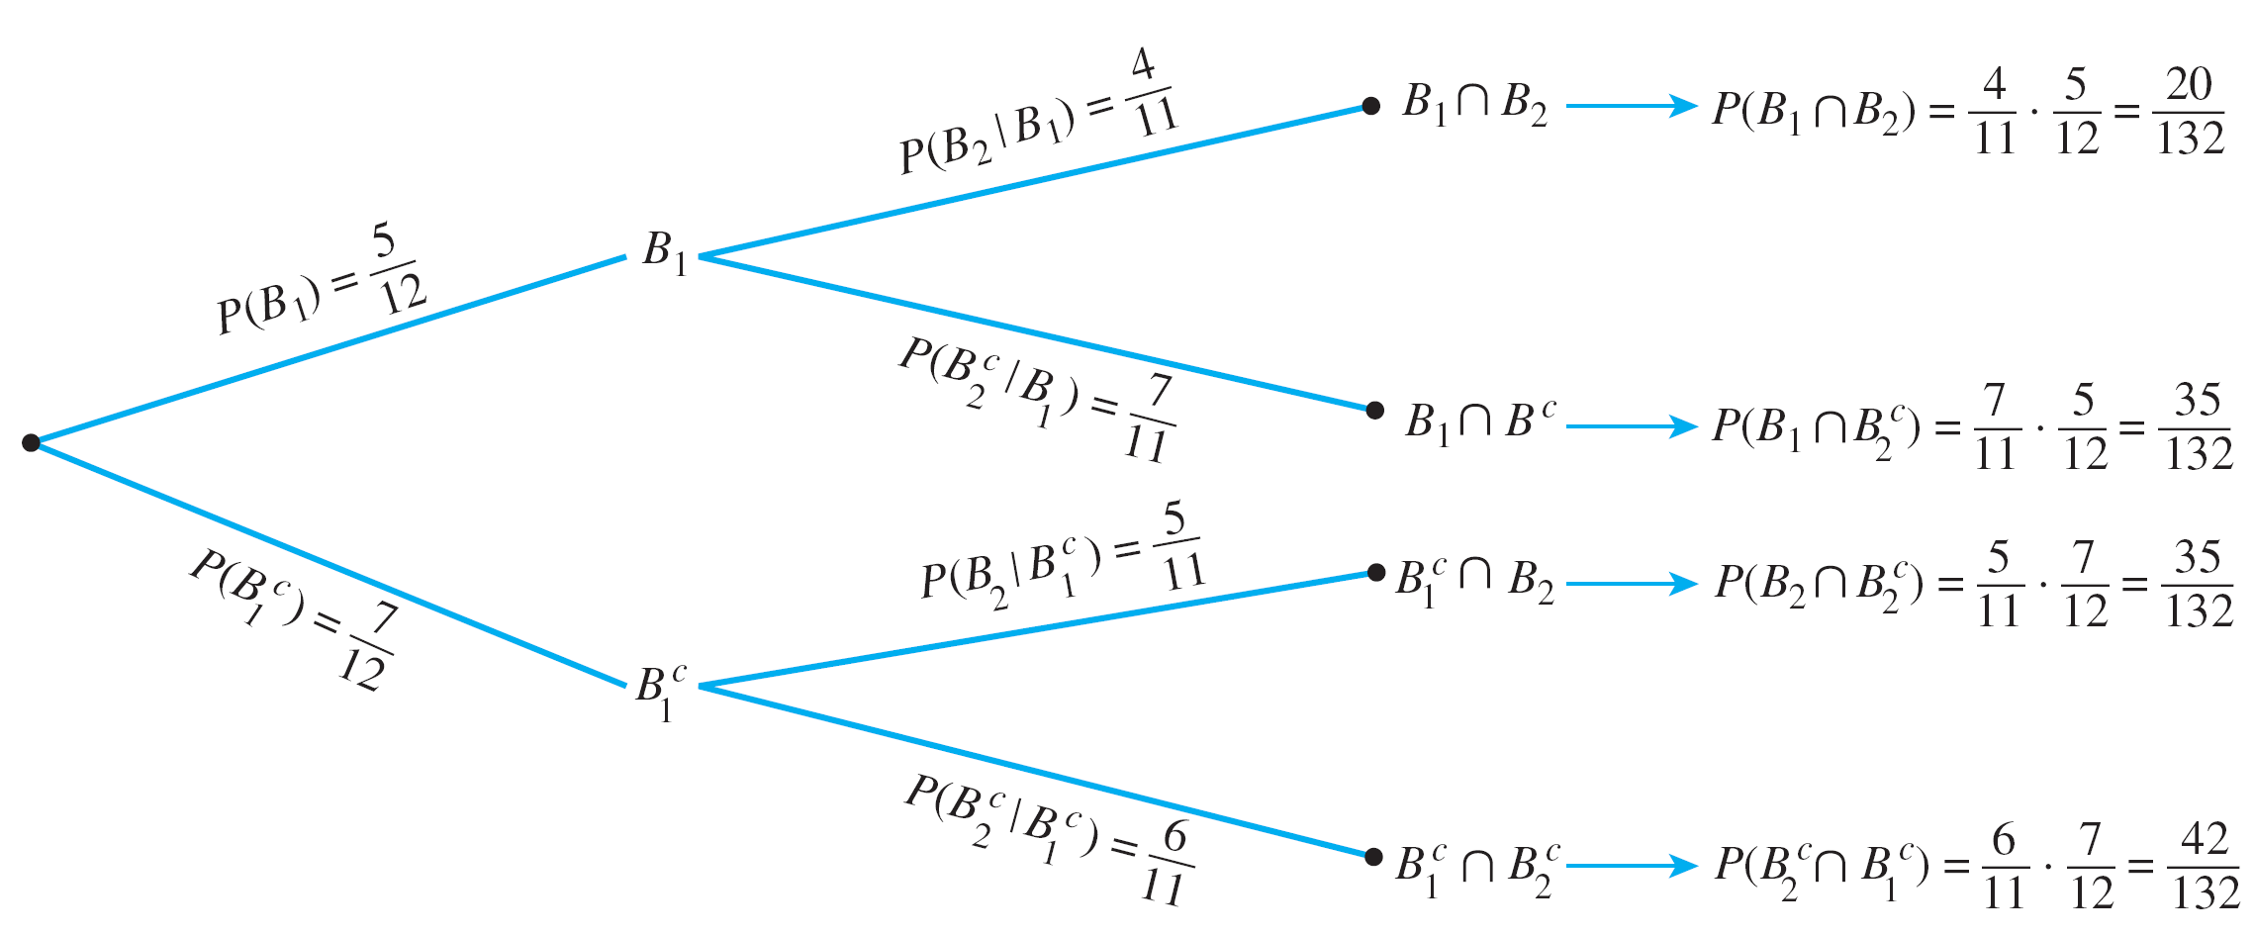
Example 2 – Solution
cont’d
The tree diagram in Figure 9.9.2 is a convenient way to
help calculate these results.
Figure 9.9.2

Slide 18
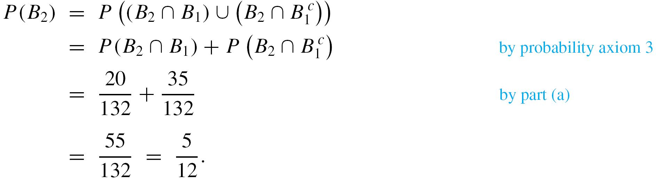
Example 2 – Solution
cont’d
b. The event that the second ball is blue can occur in one of two mutually exclusive ways: Either the first ball is blue and the second is also blue, or the first ball is gray and the second is blue. In other words, B₂ is the disjoint union of B₂ ∩ B₁ and B₂ ∩ .
Hence

Slide 19
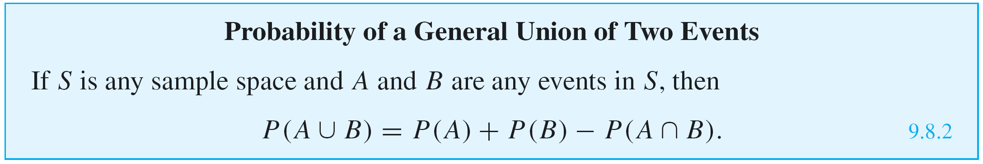
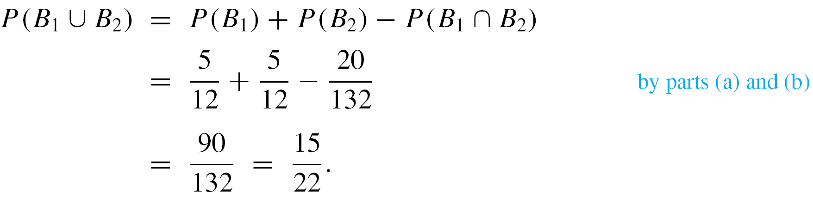
Example 2 – Solution
cont’d
Thus the probability that the second ball is blue is 5/12,
the same as the probability that the first ball is blue.
c. By formula 9.8.2, for the union of any two events,

Slide 20
Example 2 – Solution
cont’d
Thus the probability is 15/22, or approximately 68.2%,
that at least one of the balls is blue.

Slide 21
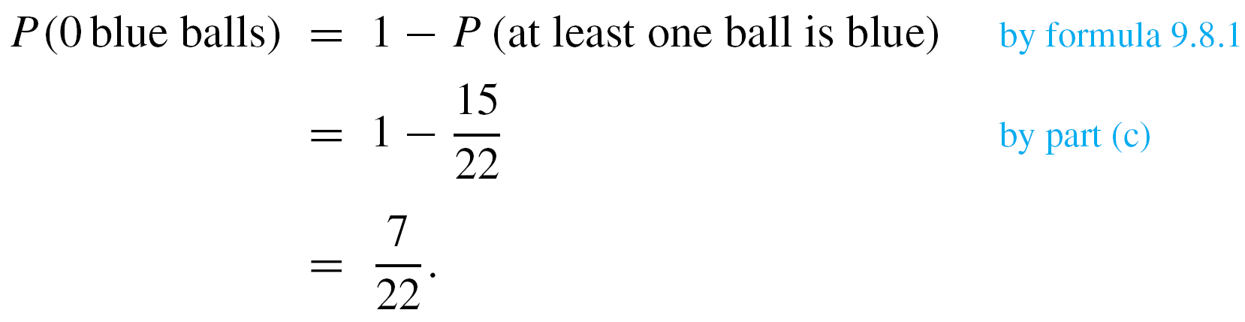
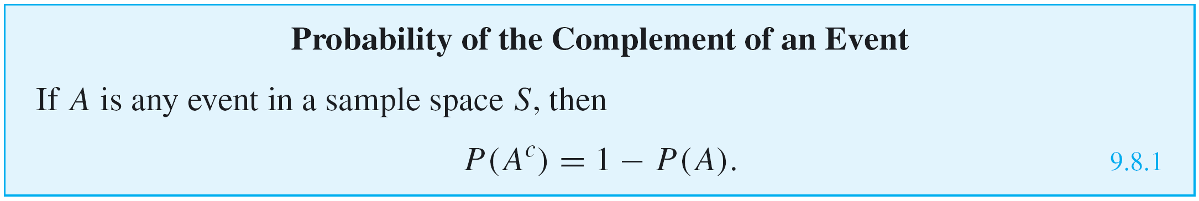
Example 2 – Solution
cont’d
d. The event that neither ball is blue is the complement of the event that at least one of the balls is blue, so

Slide 22
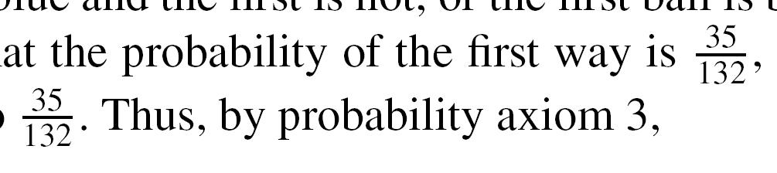
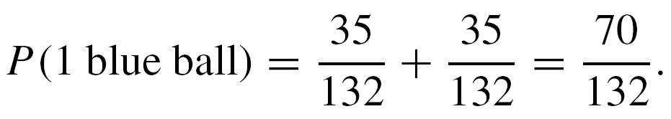
Example 2 – Solution
cont’d
The event that one ball is blue can occur in one of two mutually exclusive ways: Either the second ball is blue and the first is not, or the first ball is blue and the second is not.
Part (a) showed that the probability of the first way is ,
and the probability of the second way is also .
Thus, by probability axiom 3,

Slide 23
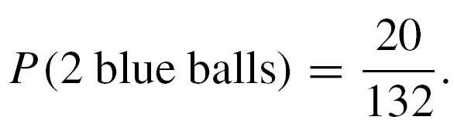
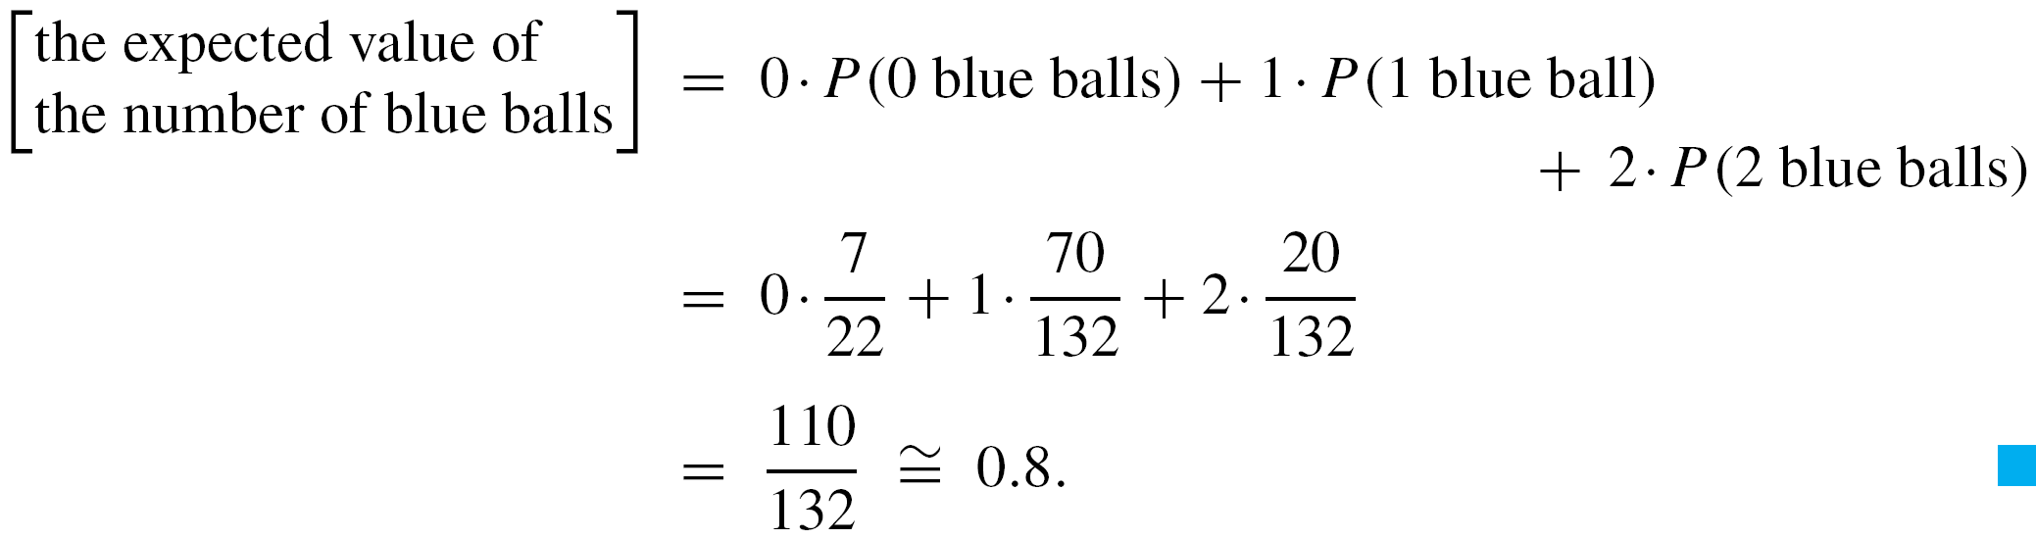
Example 2 – Solution
cont’d
Finally, by part (a),
Therefore,

Slide 24
Bayes’ Theorem

Slide 25
Bayes’ Theorem
Suppose that one urn contains 3 blue and 4 gray balls and a second urn contains 5 blue and 3 gray balls. A ball is selected by choosing one of the urns at random and then picking a ball at random from that urn. If the chosen ball is blue, what is the probability that it came from the first urn?
This problem can be solved by carefully interpreting all the information that is known and putting it together in just the right way.
Let A be the event that the chosen ball is blue, B₁ the event that the ball came from the first urn, and B₂ the event that the ball came from the second urn.

Slide 26
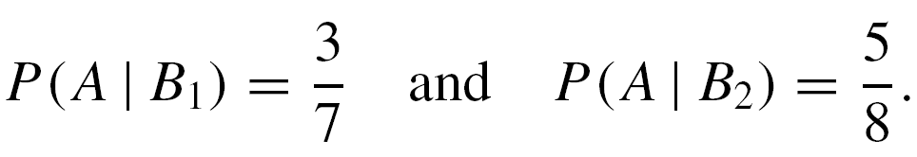
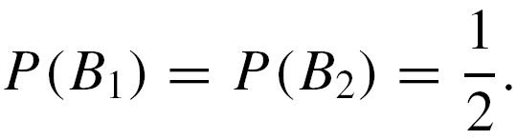
Bayes’ Theorem
Because 3 of the 7 balls in urn one are blue, and 5 of the 8 balls in urn two are blue,
And because the urns are equally likely to be chosen,

Slide 27
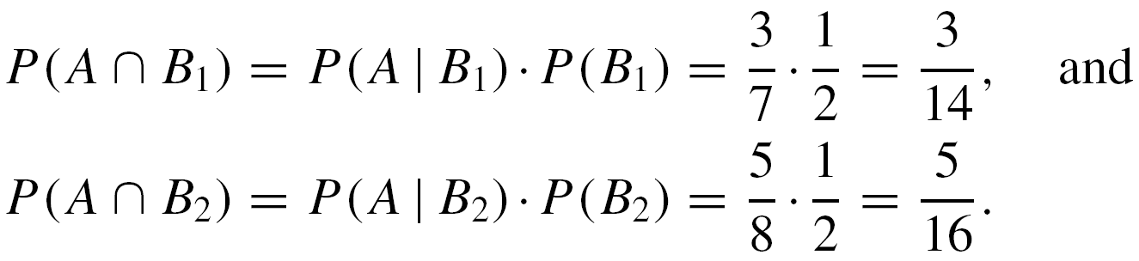
Bayes’ Theorem
Moreover, by formula (9.9.2),
But A is the disjoint union of (A ∩ B₁) and (A ∩ B₂), so by probability axiom 3,

Slide 28
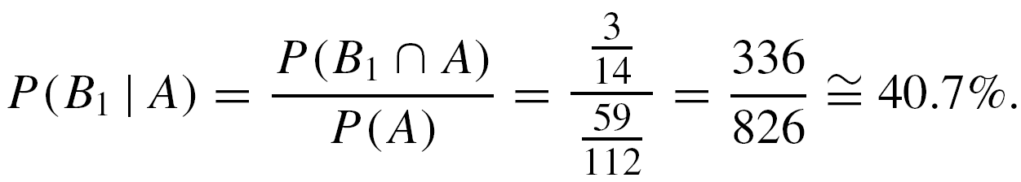
Bayes’ Theorem
Finally, by definition of conditional probability,
Thus, if the chosen ball is blue, the probability is approximately 40.7% that it came from the first urn.
The steps used to derive the answer in the previous example can be generalized to prove Bayes’ Theorem.

Slide 29
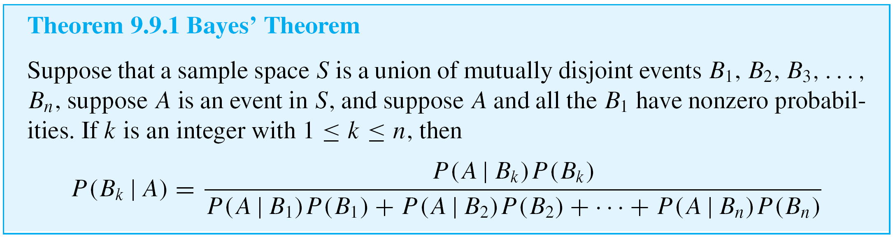
Bayes’ Theorem

Slide 30
Example 3 – Applying Bayes’ Theorem
Most medical tests occasionally produce incorrect results, called false positives and false negatives.
When a test is designed to determine whether a patient has a certain disease, a false positive result indicates that a patient has the disease when the patient does not have it.
A false negative result indicates that a patient does not have the disease when the patient does have it.

Slide 31
Example 3 – Applying Bayes’ Theorem
cont’d
When large-scale health screenings are performed for diseases with relatively low incidence, those who develop the screening procedures have to balance several considerations: the per-person cost of the screening, follow-up costs for further testing of false positives, and the possibility that people who have the disease will develop unwarranted confidence in the state of their health.
Consider a medical test that screens for a disease found in 5 people in 1,000. Suppose that the false positive rate is 3% and the false negative rate is 1%.

Slide 32
Example 3 – Applying Bayes’ Theorem
cont’d
Then 99% of the time a person who has the condition tests positive for it, and 97% of the time a person who does not have the condition tests negative for it.
a. What is the probability that a randomly chosen person who tests positive for the disease actually has the disease?
b. What is the probability that a randomly chosen person who tests negative for the disease does not indeed have the disease?

Slide 33
Example 3 – Solution
Consider a person chosen at random from among those screened. Let A be the event that the person tests positive for the disease, B₁ the event that the person actually has the disease, and B₂ the event that the person does not have the disease.
Then
Also, because 5 people in 1,000 have the disease,

Slide 34
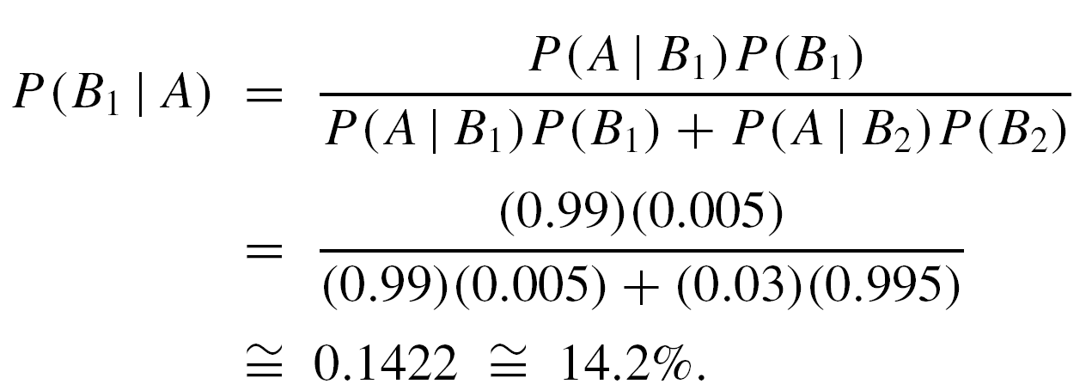
Example 3 – Solution
cont’d
a. By Bayes’ Theorem,
Thus the probability that a person with a positive test
result actually has the disease is approximately 14.2%.

Slide 35
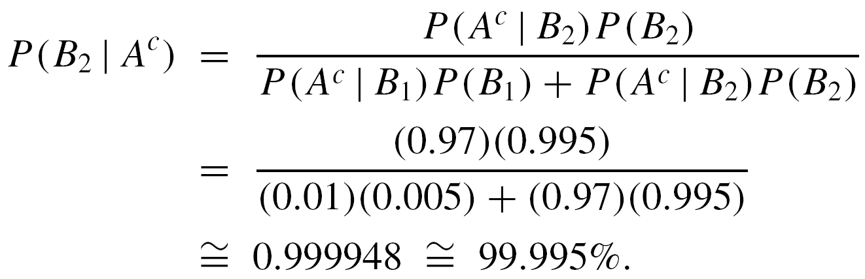
Example 3 – Solution
cont’d
b. By Bayes’ Theorem,
Thus the probability that a person with a negative test
result does not have the disease is approximately
99.995%.

Slide 36
Example 3 – Solution
cont’d
You might be surprised by these numbers, but they are fairly typical of the situation where the screening test is significantly less expensive than a more accurate test for the same disease yet produces positive results for nearly all people with the disease.
Using the screening test limits the expense of unnecessarily using the more costly test to a relatively small percentage of the population being screened, while only rarely indicating that a person who has the disease is free of it.

Slide 37
Independent Events

Slide 38
Independent Events
For instance, A is the event that a head is obtained on the first toss and B is the event that a head is obtained on the second toss, then if the coin is tossed randomly both times, events A and B should be independent in the sense that P(A | B) = P(A) and P(B | A) = P(B).
To obtain the final form for definition of independence, observe that

Slide 39
Independent Events
By the same argument,
Conversely
and

Slide 40
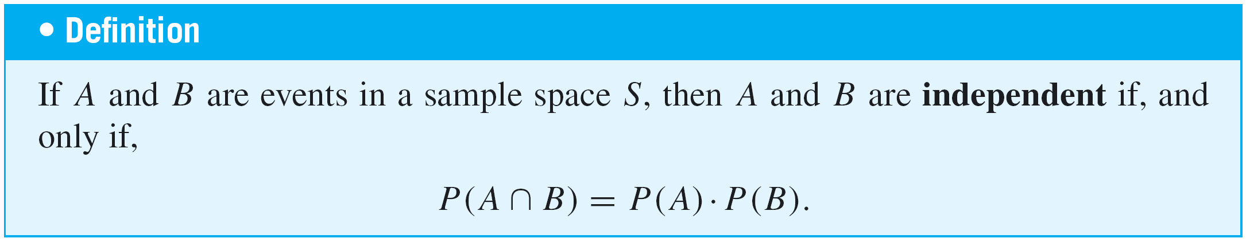
Independent Events
Thus, for convenience and to eliminate the requirement that the probabilities be nonzero, we use the following product formula to define independent events.

Slide 41
Example 6 – Computing Probabilities of Intersections of Two Independent Events
A coin is loaded so that the probability of heads is 0.6. Suppose the coin is tossed twice. Although the probability of heads is greater than the probability of tails, there is no reason to believe that whether the coin lands heads or tails on one toss will affect whether it lands heads or tails on the other toss. Thus it is reasonable to assume that the results of the tosses are independent.
a. What is the probability of obtaining two heads?
b. What is the probability of obtaining one head?

Slide 42
Example 6 – Computing Probabilities of Intersections of Two Independent Events
cont’d
c. What is the probability of obtaining no heads?
d. What is the probability of obtaining at least one head?
Solution:
The sample space S consists of the four outcomes {HH, HT, TH, TT }, which are not equally likely.
Let E be the event that a head is obtained on the first toss, and let F be the event that a head is obtained on the second toss. Then P(E ) = P(F ) = 0.6, and it is to be assumed that E and F are independent.

Slide 43
Example 6 – Solution
cont’d
a. The probability of obtaining two heads is P(E ∩ F). Because E and F are independent,

Slide 44

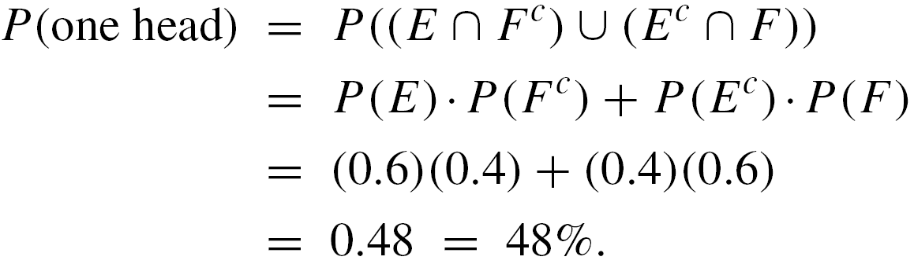
Example 6 – Solution
cont’d
b. One head can be obtained in two mutually exclusive ways: head on the first toss and tail on the second, or tail on the first toss and head on the second.
Thus, the event of obtaining exactly one head is (E ∩ ) ∪ ( ∩ F ). Also (E ∩ ) ∩ ( ∩ F) = ∅, and, moreover, by the formula for the probability of the complement of an event, P( ) = P( ) = 1 – 0.6 = 0.4.
Hence

Slide 45

Example 6 – Solution
cont’d
c. The probability of obtaining no heads is .

Slide 46
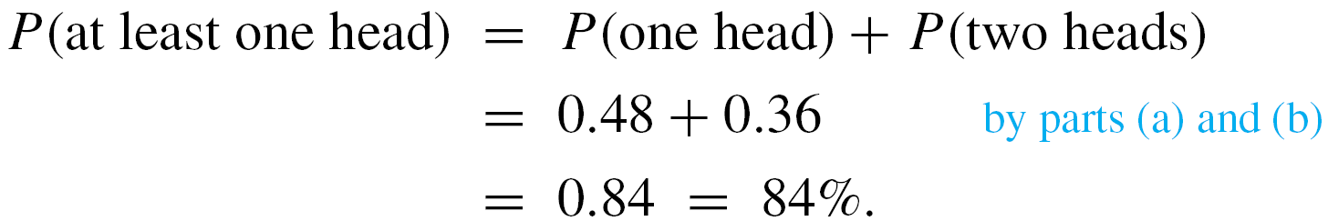
Example 6 – Solution
cont’d
d. There are two ways to solve this problem. One is to observe that because the event of obtaining one head and the event of obtaining two heads are mutually disjoint,
The second way is to use the fact that the event of
obtaining at least one head is the complement of the
event of obtaining no heads.

Slide 47
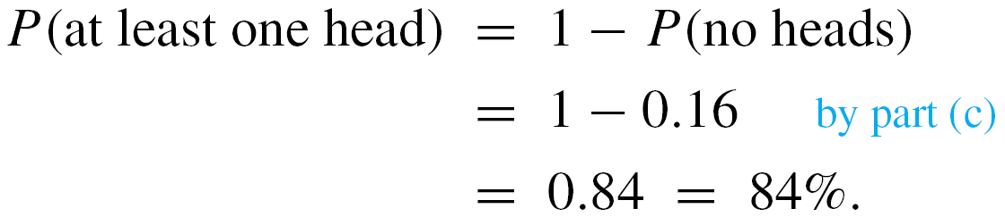
Example 6 – Solution
cont’d
So

Slide 48
Independent Events
For instance, we say three events A, B, and C are pairwise independent if, and only if,
The next example shows that events can be pairwise independent without satisfying the condition
P(A ∩ B ∩ C) = P(A)  P(B)  P(C).
Conversely, they can satisfy the condition
P(A ∩ B ∩ C) = P(A)  P(B)  P(C) without being pairwise independent.

Slide 49
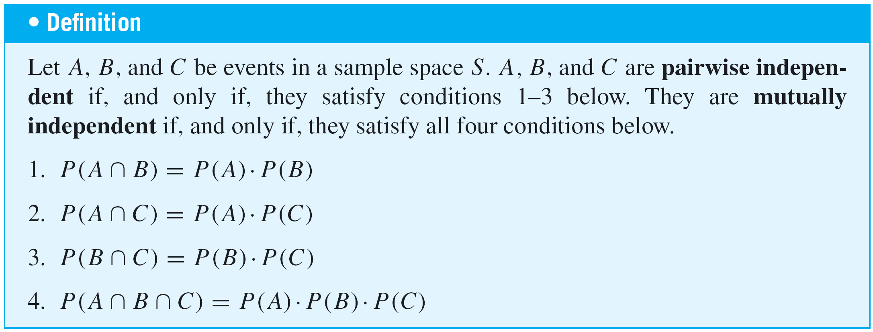
Independent Events
Four conditions must be included in the definition of independence for three events.

Slide 50
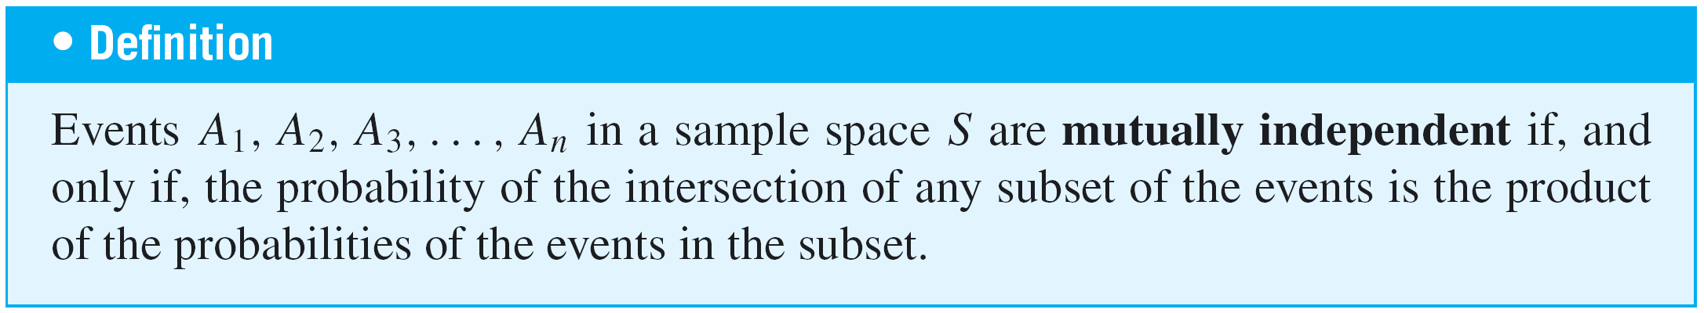
Independent Events
The definition of mutual independence for any collection of n events with n ≥ 2 generalizes the two definitions given previously.

Slide 51
Example 9 – Tossing a Loaded Coin Ten Times
A coin is loaded so that the probability of heads is 0.6 (and thus the probability of tails is 0.4). Suppose the coin is tossed ten times. As in Example 6, it is reasonable to assume that the results of the tosses are mutually independent.
a. What is the probability of obtaining eight heads?
b. What is the probability of obtaining at least eight heads?

Slide 52
Example 9(a) – Solution
For each i = 1, 2, . . . , 10, let H_{i} be the event that a head is obtained on the i th toss, and let T_{i} be the event that a tail is obtained on the i th toss.
Suppose that the eight heads occur on the first eight tosses and that the remaining two tosses are tails. This is the event
H₁ ∩ H₂ ∩ H₃ ∩ H₄ ∩ H₅ ∩ H₆ ∩ H₇ ∩ H₈ ∩ T₉ ∩ T₁₀.
For simplicity, we denote it as HHHHHHHHTT. By definition of mutually independent events,

Slide 53
Example 9(a) – Solution
cont’d
Because of the commutative law for multiplication, if the eight heads occur on any other of the ten tosses, the same number is obtained.
For instance, if we denote the event
H₁ ∩ H₂ ∩ T₃ ∩ H₄ ∩ H₅ ∩ H₆ ∩ H₇ ∩ H₈ ∩ T₉ ∩ H₁₀ by
HHTHHHHHTH, then

Slide 54
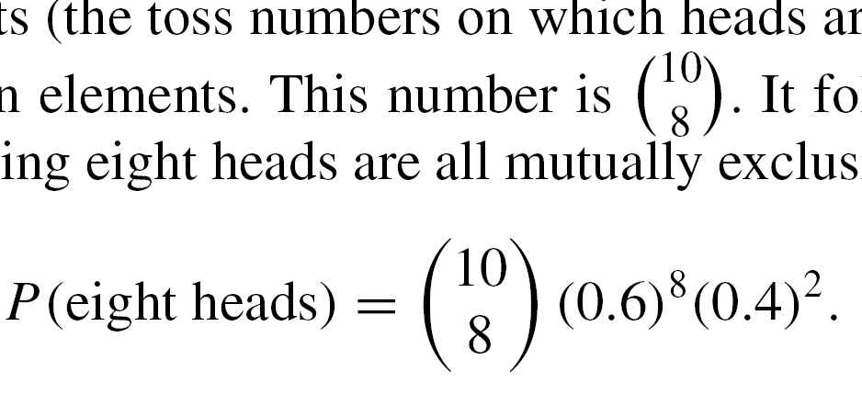
Example 9(a) – Solution
cont’d
Now there are as many different ways to obtain eight heads in ten tosses as there are subsets of eight elements (the toss numbers on which heads are obtained) that can be chosen from a set of ten elements.
This number is . It follows that, because the different ways of obtaining eight heads are all mutually exclusive,

Slide 55
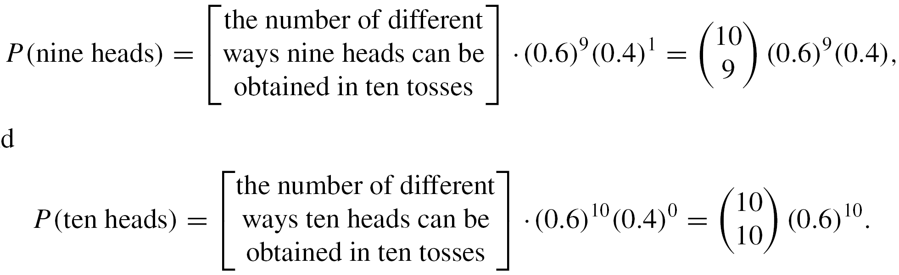
Example 9(b) – Solution
cont’d
By reasoning similar to that in part (a),
and

Slide 56
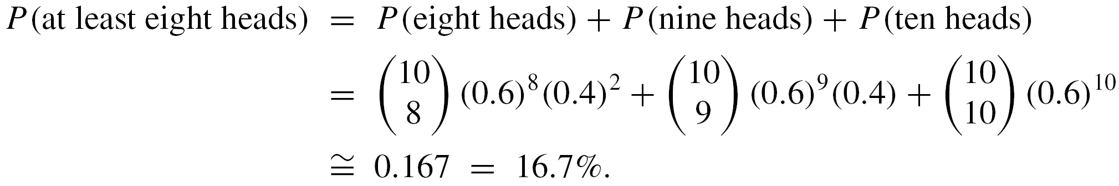
Example 9 – Solution
cont’d
Because obtaining eight, obtaining nine, and obtaining
ten heads are mutually disjoint events,

Slide 57

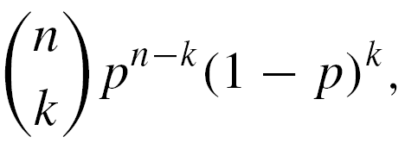
Independent Events
Note the occurrence of the binomial coefficients in
solutions to problems like the one in Example 9. For that reason, probabilities of the form
where 0 ≤ p ≤ 1, are called binomial probabilities.

